Slide 1

Darek
Making Student Housing Simple and Safe
From Relocation Stress to Seamless Settlement

Slide 2
Our Group
1
Abdulrahman Al-Fawzan - Project Manager, Backend Developer
2
Mohammad Al-Omar - Backend Developer, QA Support
3
Meshari Al-Abdullah - UI/UX Lead, Frontend Developer
4
Abdulelah Al-Shehri - Frontend Developer

Slide 3
Why We Started
Every year, thousands of students face the overwhelming challenge of relocating for university. Finding safe, affordable housing in an unfamiliar city can be stressful, time-consuming, and risky.
Darek was created to transform this experience — making the process easier, faster, and more trustworthy for students starting their academic journey.

Slide 4



The Need
Students Searching
Market Gap
Owners Seeking
Struggling to find verified, affordable housing near campus
No trusted platform connecting students with property owners
Property owners want reliable, verified student tenants
Darek bridges this gap by creating a verified platform where students and property owners can connect with confidence and transparency by verifying listings, authenticating user identities, and facilitating secure communication For reservations.

Slide 5
Other Solutions in the Market and their disadvantages
What students in Saudi Arabia currently use to find housing
Bayut KSA & ِ Acar:
A large property-listing website with apartments and rooms for rent.
Haraj & Twitter (Social Platforms / Classifieds):
Commonly used by students to find rooms and landlords directly.
Individual Landlord Websites & University Boards:
Some landlords or student housing compounds post their own websites or notice boards.

Slide 6
Our Purpose
To provide a secure, easy-to-use housing platform that helps students find suitable, affordable homes and helps property owners share verified listings.
We're committed to building trust in the student housing market through verification, transparency, and user-friendly technology.

Slide 7

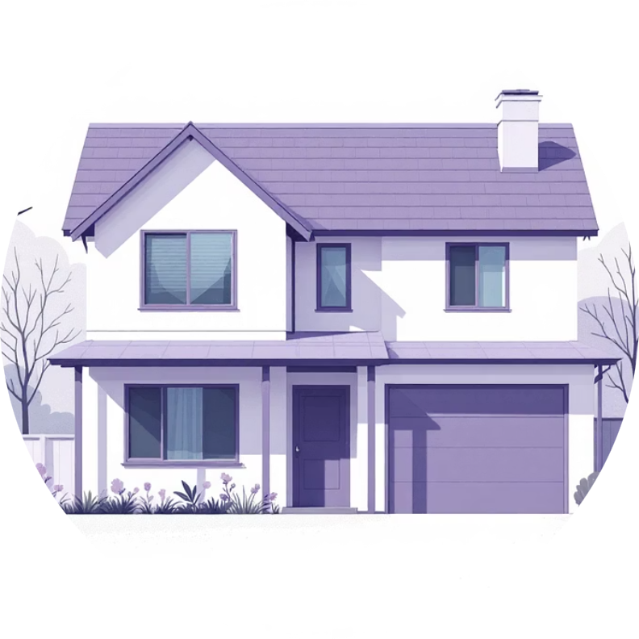
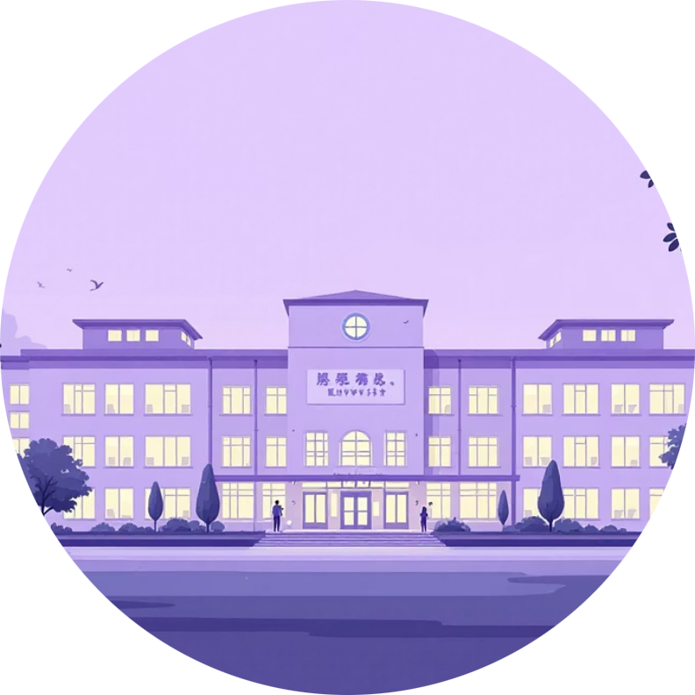
Who Benefits
Students
Property Owners
Universities
Faster, easier housing search with verified listings and roommate matching
Simple listing management with access to verified student tenants
Better support for relocating students, improving retention and satisfaction

Slide 8
Key Features
1
2
3
Smart Filters
Verified Messaging
Roommate Matching
Search by price range, distance from campus, amenities, and more to find the perfect match quickly
Built-in secure messaging between verified users ensures safe, transparent communication
Connect with compatible roommates based on preferences, lifestyle, and budget
4
Listing Verification
All properties are verified for authenticity, ensuring trust and safety

Slide 9
Tools & Technology Stack
Backend & Database
Frontend & Integration
Django: Robust Python web framework
Typescript/React: Responsive design
PostgreSQL: Reliable relational database
Twilio: Messaging capabilities
Wathiq: landlord identity verification and document validation.
Netlify: deploying and hosting the frontend web application.
Railway: deployment platform for hosting and managing the backend.
Coordination and work division
Discord: Team communication platform for sharing updates, blockers, and progress.
GitHub: Source control and collaboration tool for managing code versions and pull requests.

Slide 10




Why These Tools?
Cost Efficiency
Ease of Use & Integration
Used free and open-source technologies to stay within budget
Chosen platforms like Railway and Netlify for their simple deployment process
Development Speed
Team Expertise
Optimized for speed and seamless user experience
Aligned with our skills and realistic development timeline

Slide 11
Our Impact
Faster Discovery
Better Occupancy
Cost Savings
Verified Safety
Students find housing three times faster than traditional methods
Property owners see improved occupancy rates with verified tenants
Average monthly savings for students through competitive listings
All users and listings verified for a safer housing experience
Join us in transforming student housing — creating safer, simpler, and more affordable living solutions for the next generation.

